Slide 1
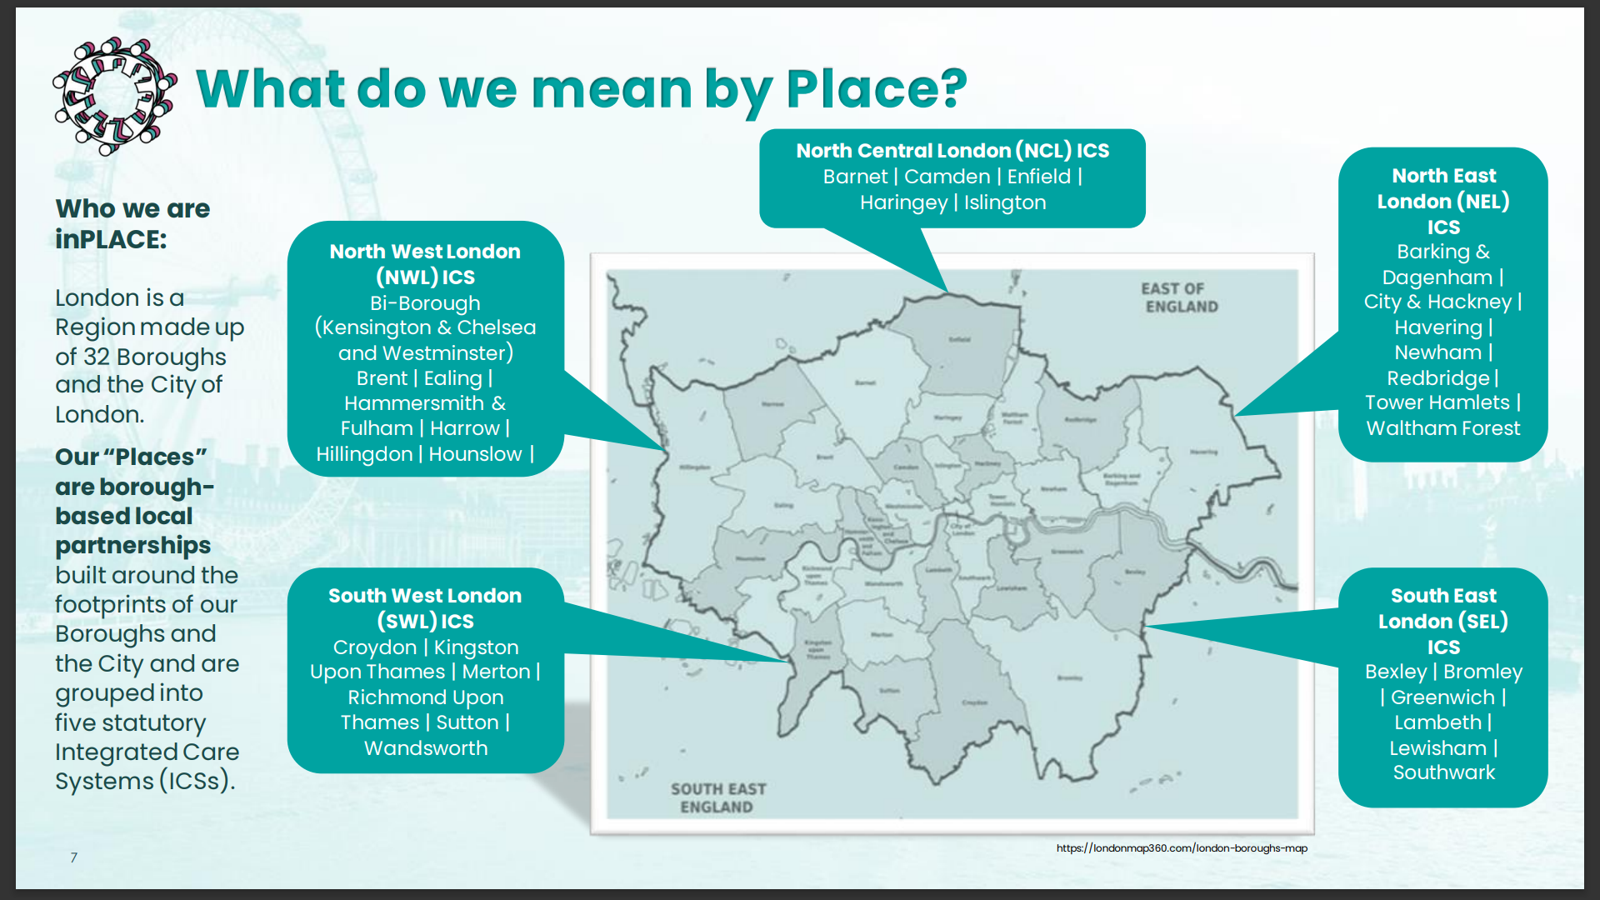
Background
“Low Touch” Phase 1 ICB changes of July 2022
  ICB codes: No change to codes nor relationships, but Non-Primary roles changed from STP to ICB
  CCG codes: No changes to codes nor relationships, but new Non Primary role of ‘ICB sub location (SICBL)’ introduced.
Mixed Economy “26+16” Due to CCG Mergers pre-July 2022
  26 ICBs with a single sub-ICB location (SICBL)
    sub-ICB location name is misleading – there is no granularity
  16 ICBs with multiple SICBLs
    Which code do we use for new commissioning e.g. new GPs?
    Which code do we link new ICB sites to?
Relevance of ODS Codes
  Data warehouses that underpin analytical products dashboard use the ODS reference tables for ‘drill-down’
  ODS codes use in finance:
    No ill-effects of the “26+16” over 15 months
    New finance systems allows ICBs to set up ‘Place’ as cost centres
  In some instances e.g. Continuing Healthcare (CHC) Patient Level Dataset (PLDS), retired ODS codes are used in submissions (see next slide for examples)
Place Definition & Maturity Varied Across UK
  DHSC Shared Outcome Frameworks Toolkit
    ‘Place’ level is the engine for delivery and reform.
  Finance Place based Allocations tool
    Allows ICBs to plan by relative needs – based on groups of GPs (Streamlit) place-based-tool-user-guide.pdf (england.nhs.uk) (July 2022)
  London has inPLACE maturity assessment

Slide 2
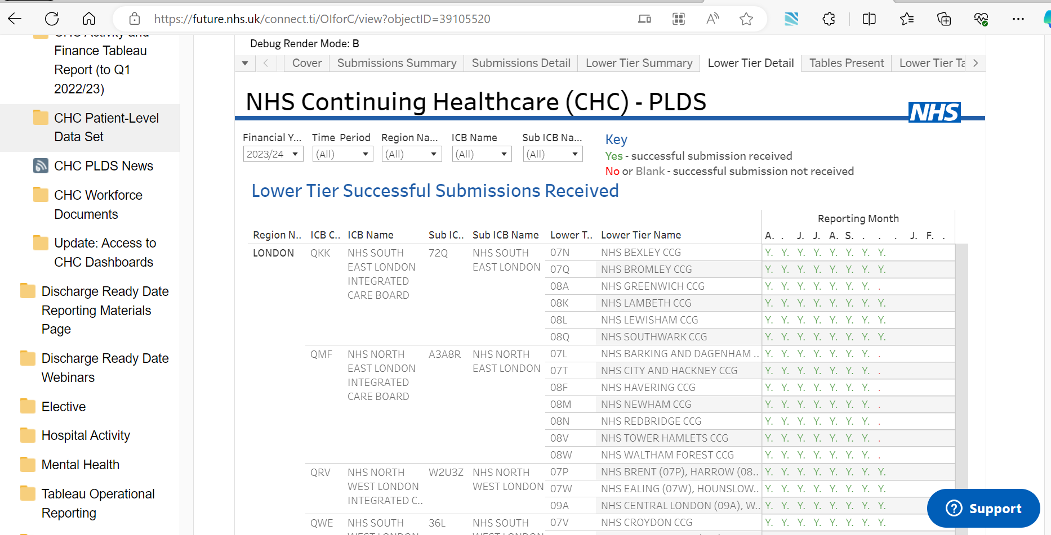
London – CHC PLDS Data Submissions Using Defunct ODS Codes

Slide 3
London – Meaningful Sub-ICB Location Codes
CCG Mergers – 32 CCGs became 5 CCG, then 5 SICBLs
  Sub ICB Location codes meaningless to service users – refer to same ‘footprint’ as the 5 ICBs
Multiple Requests to ODS to Re-instate Codes for 32 CCGs
  Oct-20: Issues highlighted during CCG Mergers
  Sep-22: London Performance Analysis Team (PAT)
  Aug-23 onwards: Multiple requests
Problem 1 - Loss of Relevant Data Granularity
  Loss of Relevant Data for Planning
  Micro-Commissioning Challenges & Potential IG Breaches
  Additional Workload
  Inaccurate Reporting on National Dashboards
  Inconsistent Apportionment of Data
Problem 2: Inequality
  Inability to Identify Inequalities of Service
  Inconsistent Reference Data
Problem 3: Appropriate System Access
  Inefficiency
Proposed Solution for or April 2024
  ICB Commissioning Proxy
    Retain SICBL code but replace current SICBL role
    Retain name of code
    Continue to hold all Commissioning relationships
    Change relationship type to ICB
  Sub-ICB Reporting Entity (SI-RE)
    New Non-primary role
    Defined by GP practices in former CCGs
      GP practices associated with former CCGs plus changes since mid-2020
    New relationship type to link GP practices to SI-RE
Communication & Preparation
  ODS Newsletter – check with all ODS users for any likely implications of solution
  State this a request from the London ICBs and Region
  Work with OC1s of the 5 London ICBs on the list of GP practices

Slide 4
Diagrams for Clarity
Current Situation, Proposed London Interim Solution
Please view in ‘Slide Show’ mode – there are builds

Slide 5



Current Model
Mixed Economy “26+16”
Health Authority
RO132
NHSE Region
Strategic Partnership
RO261
42 ICB Names
26 ICBs with only one
‘sub’ ICB location
16 ICBs with multiple
sub-ICB locations
Integrated Care Board RO318
    This tier does not support ‘sites’
Geography of (RE5)
OrgType RO98
Geography of (RE5)
Clinical Commission-ing Group
RO98
Sub ICB Location
RO319
106 Sub-ICB Locations
Commissioning Hub
RO218
Regional Commissioning Hub
Operated by (RE6)
CCG Site
RO99
1,359 Sites
Health & Justice /Specialised Comm
Prescribing Cost Centre (PCC) RO177
Commissioned by (RE4)
Operated by (RE6)
PCN
GP Practice RO76
Other PCCs
Other PCCs
Primary Care Network
GP Practice
Other PCCs
Other PCCs
PCNs
RO272
Partner OR
Nominated Payee (RE9)
Commissioned by (RE4)
Is Partner To (RE8)
Pharmacy
Pharma
Pharm-acy
Trust
Trust
Ambulance & Community Care services
Optical
Various
Optical
Optician
Dental
Dental
Dental Service
Trust
Social Care
Primary Role
Non-Primary Role

Slide 6
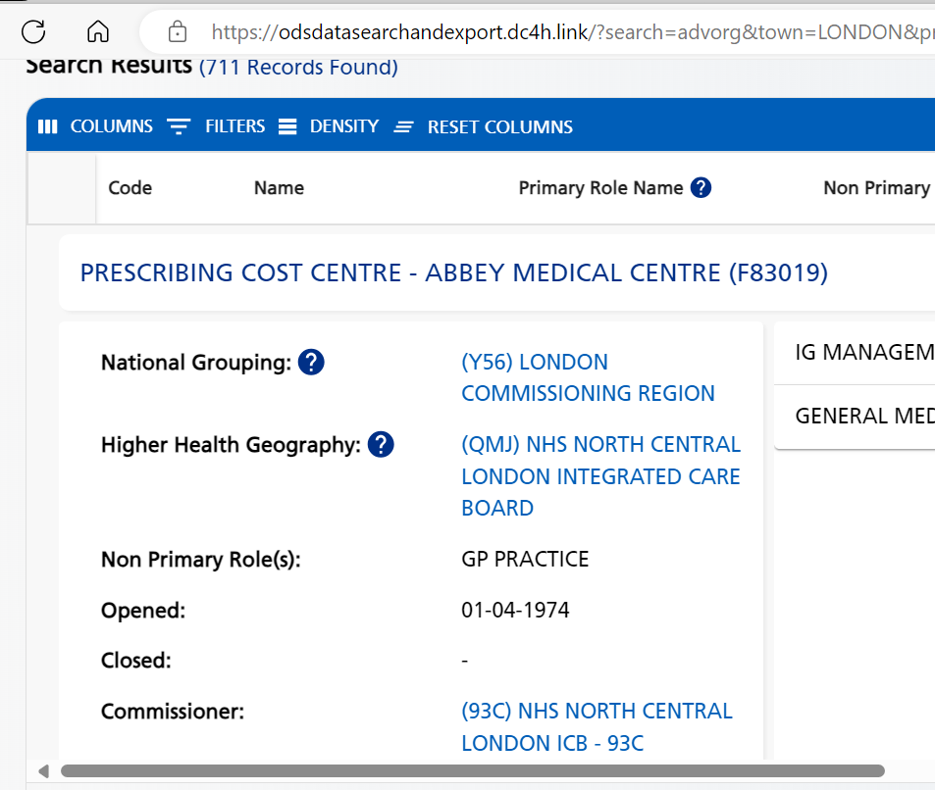
How These Are Presented on the ODS – DSE/Portal
Health Authority
RO132
NHSE Region
Strategic Partnership
RO261
42 ICB Names
Integrated Care Board RO318
    This tier does not support ‘sites’
OrgType RO98
Geography of
Clinical Commission-ing Group
RO98
Sub ICB Location
RO319
106 Sub-ICB Locations
Operated by
CCG Site
RO99
1,359 Sites
Prescribing Cost Centre (PCC) RO177
Commissioned by
Operated by
PCN
GP Practice RO76
Other PCCs
Other PCCs
Primary Care Network
GP Practice
Other PCCs
Other PCCs
PCNs
RO272
Partner OR
Nominated Payee

Slide 7
Current Model – Mixed Economy Illustration
Mixed Economy “26+16”
Health Authority
RO132
NHSE Region
26 ICBs with only one
‘sub’ ICB location
16 ICBs with multiple
sub-ICB locations
Strategic Partnership
RO261
26 ICB Names
Integrated Care Board RO318
16 ICB Names
Integrated Care Board
1 to 1
Geography of
Geography of
Geography of
Geography of
Clinical Commission-ing Group
RO98
Sub ICB Location
RO319
Sub ICB Location RO319
80 Sub-ICB Locations
Sub ICB Location
RO319
Sub ICB Location
RO319
26 Sub-ICB Locations
Sub-ICB Location 1
Sub-ICB Location 2
Sub-ICB Location 3
Sub ICB Location
Sub-ICB Location 4
Operated by
Operated by
Operated by
CCG Site
RO99
CCG Site
CCG Site
Site
Sites
Site
Prescribing Cost Centre (PCC) RO177
Commissioned by
Operated by
Commissioned by
Operated by
Commissioned by
Operated by
Commissioned by
Other PCCs
Other PCCs
PCN
GP Practice
Other PCCs
Other PCCs
PCN
GP Practice RO76
Other PCCs
Other PCCs
PCN
GP Practice
Other PCCs
Other PCCs
Primary Care Network
GP Practice
Other PCCs
Other PCCs
PCN
GP Practice
Primary Care Network
GP Practice
Other PCCs
Primary Care Network
GP Practice
Other PCCs
Primary Care Network
GP Practice
PCNs
RO272
Partner OR
Nominated Payee
Partner OR
Nominated Payee
Partner OR
Nominated Payee
Partner OR
Nominated Payee
Pharmacy
Optical
Dental
Trust
Social Care
Primary Role
Non-Primary Role

Slide 8
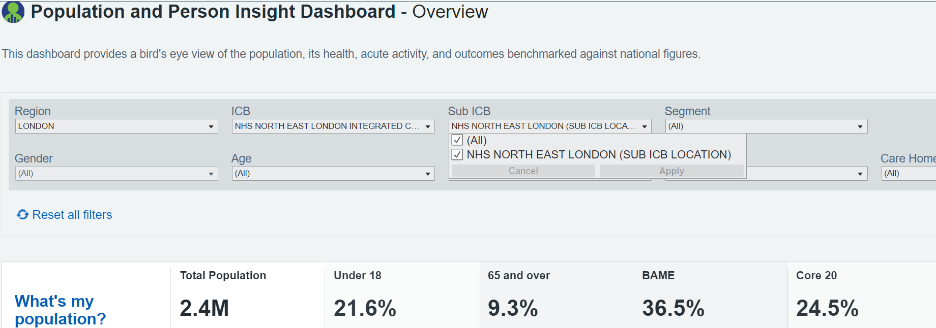
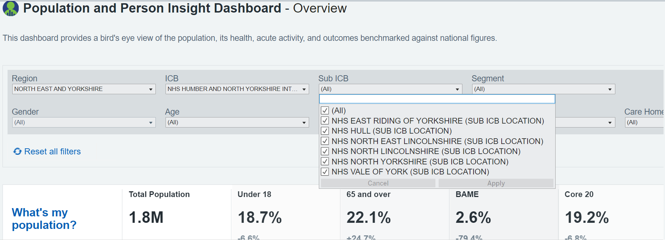
Manifestation of Mixed Economy - Lack of Granularity: PaPI National Dashboard
London ICB with only one
‘sub’ ICB
location
ICB with multiple
sub-ICB
locations
Uses Continuing Healthcare (CHC) programme local table to provide meaningful names (ex CCG) for sub ICB locations codes
https://apps.model.nhs.uk/report/PaPi.
Primary Role
Non-Primary Role

Slide 9
Current Model
Health Authority
RO132
NHSE Region
Strategic Partnership
RO261
42 ICB Names
Integrated Care Board RO318
    This tier does not support ‘sites’
Geography of
Geography of (RE5)
OrgType RO98
Geography of (RE5)
Clinical Commission-ing Group
RO98
Sub ICB Location
RO319
106 Sub-ICB Locations
Commissioning Hub RO218
Sub ICB Location
Regional Commissioning Hub
Sub-ICB Location 3
Operated by (RE6)
Operated by
CCG Site
RO99
1,359 Sites
CCG Site
Site
Health & Justice /Specialised Comm
Commissioned by (RE4)
Operated by (RE6)
Prescribing Cost Centre (PCC) RO177
Commissioned by
Operated by
PCN
GP Practice
RO76
Other PCCs
Other PCCs
1,273 PCNs
6,544 GP Practs
5,278 Other PCCs
5,269 Other PCCs
Other PCCs
Other PCCs
PCN
GP Practice
Other PCCs
Other PCCs
Primary Care Network
GP Practice
PCNs
RO272
Partner OR
Nominated Payee (RE9)
Commissioned by
Is Partner To (RE8)
Commissioned by (RE4)
Is Partner To
Pharmacy
Pharma
Pharm-acy
Trust
Trust
Ambulance & Community Care services
Optical
Various
Optical
26 ICBs with only one ‘sub’ ICB location
Optician
Dental
Dental
16 ICBs with multiple sub-ICB locations
Dental Service
Trust
Social Care
Primary Role
Non-Primary Role
New
Change

Slide 10

London Interim Solution: Introduce ICB Commissioning Proxy Role
Health Authority
RO132
NHSE Region
Retain SICBL code and name for the 5 entities.
  No changes to all commissioned & operated by entities
  No changes to sites linked to the 5 SICBLs
  No changes to relationship type to ICB of “Geography of”.
Introduce new non-primary role of “ICB Commissioning Proxy”
  Add role of “ICB Commissioning Proxy” to these 5 codes
Strategic Partnership
RO261
42 ICB Names
Integrated Care Board RO318
5 London ICBs
Other 21+16 ICBs
Geography of (RE5)
Geography of (RE5)
ICB Commissioning Proxy
OrgType RO98
Geography of (RE5)
Some changes for 5 codes:
36L, A3A8R, 72Q, W2U3Z, 93C
5 ICB Proxies
Clinical Commission-ing Group
RO98
Sub ICB Location
RO319
Sub ICB Location
RO319
101 Sub-ICB Locations
5 Sub-ICB Locations
Commissioning Hub
Sub ICB Location
Regional Commissioning Hub
Sub-ICB Location 3
Operated by (RE6)
Operated by (RE6)
Operated by
CCG Site
RO99
CCG Site
RO99
1,321 Sites
38 Sites
CCG Site
Site
Commissioned by
Health & Justice /Specialised Comm
Commissioned by (RE4)
Operated by (RE6)
Prescribing Cost Centre (PCC) RO177
Commissioned by
Operated by
Operated by
Operated by
PCN
GP Practice
RO76
Other PCCs
Other PCCs
Other PCCs
1,078 PCNs
5,346 GP Practs
4,588 Other PCCs
4,581 Other PCCs
PCN
GP Practice
RO76
Other PCCs
688 Other PCCs
Other PCCs
Other PCCs
195 PCNs
1,198 GP Practs
690 Other PCCs
PCN
GP Practice
Other PCCs
Other PCCs
Primary Care Network
GP Practice
PCNs
RO272
Partner OR
Nominated Payee (RE9)
Partner OR
Nominated Payee
Commissioned by (RE4)
Is Partner To (RE8)
Partner OR
Nominated Payee
Pharmacy
Pharma
Pharm-acy
Trust
Trust
Ambulance & Community Care services
Optical
Various
Optical
Optician
Dental
Dental
Dental Service
Trust
Social Care
Primary Role
Non-Primary Role
New
Change

Slide 11
London Interim Solution: Introduce Sub-ICB Reporting Entity Codes
Health Authority
RO132
NHSE Region
Introduce new Non-primary role of Sub-ICB Reporting Entity (SI-RE)
  Issue SI-RE codes for the London based on pre-merger CCGs named as agreed with ICBs
  ‘Sub-division of’ relationship to the parent ICB
Define SI-RE using Prescribing Cost Centres (RO117) including GP practices using new relationship type of “Constituent of” based on ICB verified list
New data to be available via the ODS API only from 1st April 2024
  Available on ODS-DSE Beta version from July 2024.
Strategic Partnership
RO261
42 ICB Names
Integrated Care Board
5 London ICBs
Other 21+16 ICBs
Sub-division of (RE2)
Geography of (RE5)
Geography of (RE5)
ICB Commissioning Proxy
OrgType RO98
Geography of (RE5)
5 ICB Proxies
Clinical Commission-ing Group
RO98
Sub ICB Location
RO319
Sub ICB Location
RO319
101 Sub-ICB Locations
5 Sub-ICB Locations
Commissioning Hub
Sub-ICB Reporting Entity
Regional Commissioning Hub
Sub ICB Location
32 Sub-ICB Reporting Entities (SI-RE)
Sub-ICB Location 3
Operated by (RE6)
Operated by (RE6)
Operated by
CCG Site
RO99
CCG Site
RO99
1,321 Sites
38 Sites
CCG Site
Site
Constituent of
Commissioned by
Health & Justice /Specialised Comm
Commissioned by (RE4)
Constituent of
Operated by (RE6)
Prescribing Cost Centre (PCC) RO177
Commissioned by
Operated by
Operated by
Operated by
PCN
GP Practice
RO76
Other PCCs
Other PCCs
Other PCCs
1,078 PCNs
5,346 GP Practs
4,588 Other PCCs
4,581 Other PCCs
PCN
GP Practice
RO76
Other PCCs
688 Other PCCs
Other PCCs
Other PCCs
195 PCNs
1,198 GP Practs
690 Other PCCs
PCN
GP Practice
Other PCCs
Other PCCs
Primary Care Network
GP Practice
PCNs
RO272
Partner OR
Nominated Payee (RE9)
Partner OR
Nominated Payee
Commissioned by (RE4)
Is Partner To (RE8)
Partner OR
Nominated Payee
Pharmacy
Pharma
Pharm-acy
Trust
Trust
Ambulance & Community Care services
Optical
Various
Optical
Optician
Dental
Dental
Dental Service
Trust
Social Care
Primary Role
Non-Primary Role
New
Change

Slide 12
London Interim Solution: A Summary View
ODS Code(s) | Primary Role (Organisation Type) [Role Code] | Non-Primary Role 1 [Role Code] | Non-Primary Role 2 [Role Code] | Parent & Relationship [Relationship Code] | Children & Relationship(s) [Relationship Code] | ODS Code Name
36L, A3A8R, 72Q, W2U3Z, 93C | Clinical Commissioning Group [RO98] | Sub ICB Location [RO319] | ICB Commissioning Proxy [tbc] | ICB Geography of [RE5] | Prescribing Cost Centres (PCCs) Commissioned by [RE4] Operated by [RE6] | Current Names (No Change)
32 New Codes | Clinical Commissioning Group [RO98] | Sub-ICB Reporting Entity [tbc] | n/a | ICB Sub-Division of [RE2] | Prescribing Cost Centres (PCCs) Constituent of [tbc] | Former Borough Based CCG names
New
New
New
New
New
Non-Primary Role “ICB Commissioning Proxy” indicates presence of other codes with Non-Primary Role of “Sub-ICB Reporting Entities”

Slide 13
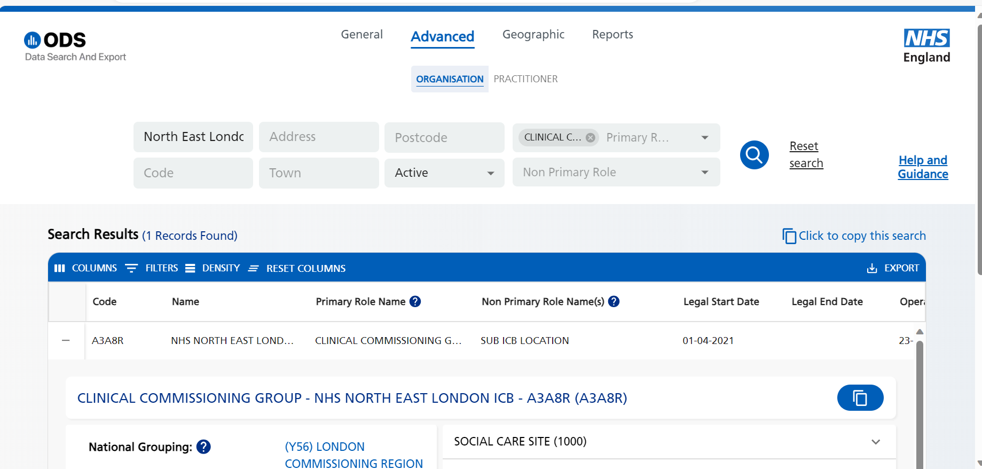
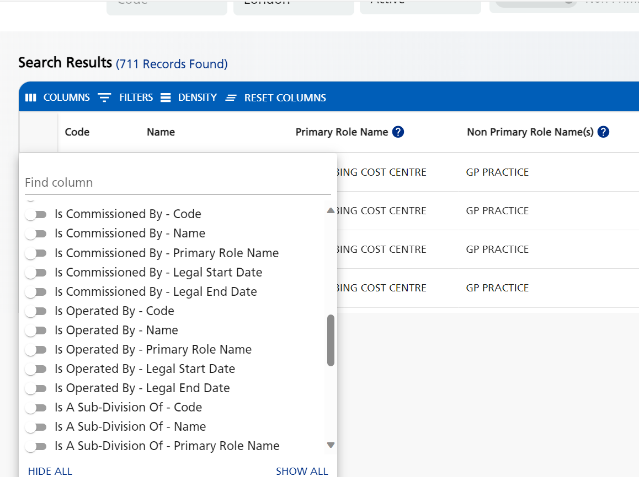


Surfacing the New Data on ODS DSE
Search for ICB Commissioning Proxy
Should also show ICB Commissioning Proxy
To see ICB Commissioning Proxy
Add new relationship to see Sub-ICB Reporting Entity (SI-RE)

Slide 14
Differences Between London Interim Solution & ‘Place’
 | Interim London Solution | Place
Requirement | Multiple ODS service tickets | No requests except Humber & North Yorkshire ICB, Suffolk & North East Essex ICB
Timeline | April 2024 | April 2025 or later
Definition | GP Practices | TBD – GP Practices, ONS LSOAs (Local Authority boundaries) or Combination
Input of Definition | ICBs to provide GP lists & sub-ICB entity names | TBD – possibly use FDP Place mapping tool
Names | Former CCG names; not all align with Boroughs | Place names e.g. Westminster vs Central London
Possible Pathway to ‘Place’ for London
Retain SI-RE Codes
  Change Primary and/or Non-Primary Role to ‘Place’
  Change relationships types to reflect ‘place’ model
Review use of ICB Commissioning Proxy Role & Code
  Will depend on how commissioning needs to be shown for Commissioning dataset returns etc.
Add Geographic Boundary Definition
  London Borough boundaries based on ONS LSOAs
Input of Definitions
  Move to providing definition on agreed national tool e.g. FDP ‘place’ mapping tool.
Summary
  Could be low impact transition but will depend on commissioning relationship requirements

